Slide 1
HEART DISEASE PREDICTION
USING
MACHINE LEARNING

Slide 2
Contents
UML Diagrams
Dataset
Implementation

Slide 3
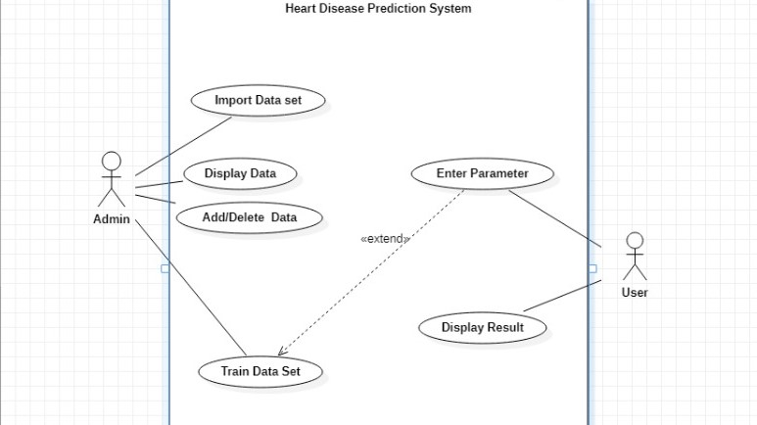
USE-CASE

Slide 4
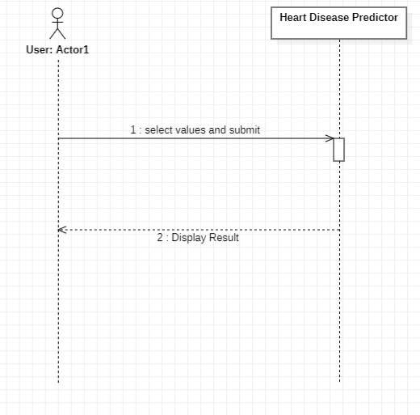
SEQUENCE DIAGRAM

Slide 5
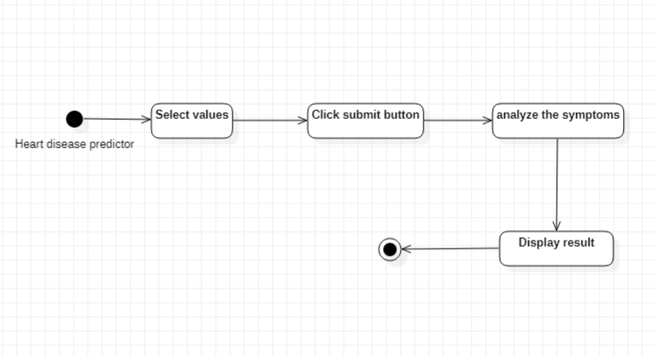
STATE CHART DIAGRAM

Slide 6
DATASET
The dataset is collected from Kaggle.
It consists of 14 attributes.
Our dataset consists of 3 types of data
Continuous
Ordinal data
Binary data

Slide 7
ATTRIBUTES
1. age (#) 2. sex : 1= Male, 0= Female (Binary) 3. (cp)chest pain type (4 values -Ordinal):Value 1: typical angina ,Value 2: atypical angina, Value 3: non-anginal pain , Value 4: asymptomatic 4. (trestbps) resting blood pressure (#) 5. (chol) serum cholesterol in mg/dl (#)

Slide 8
ATTRIBUTES
6. (fbs)fasting blood sugar > 120 mg/dl(Binary)(1 = true; 0 = false) 7. (restecg) resting electrocardiography results(values 0,1,2) 8. (thalach) maximum heart rate achieved (#) 9. (exang) exercise inlduced angina (binary) (1 = yes; 0 = no) 10. (oldpeak) = ST depression induced by exercise relative to rest (#)

Slide 9
ATTRIBUTES
11. (slope) of the peak exercise ST segment (Ordinal) (Value 1: up sloping , Value 2: flat , Value 3: down sloping ) 12. (ca) number of major vessels (0–3, Ordinal) colored by fluoroscopy 13. (thal) maximum heart rate achieved — (Ordinal): 3 = normal; 6 = fixed defect;
7 =reversible defect

Slide 10
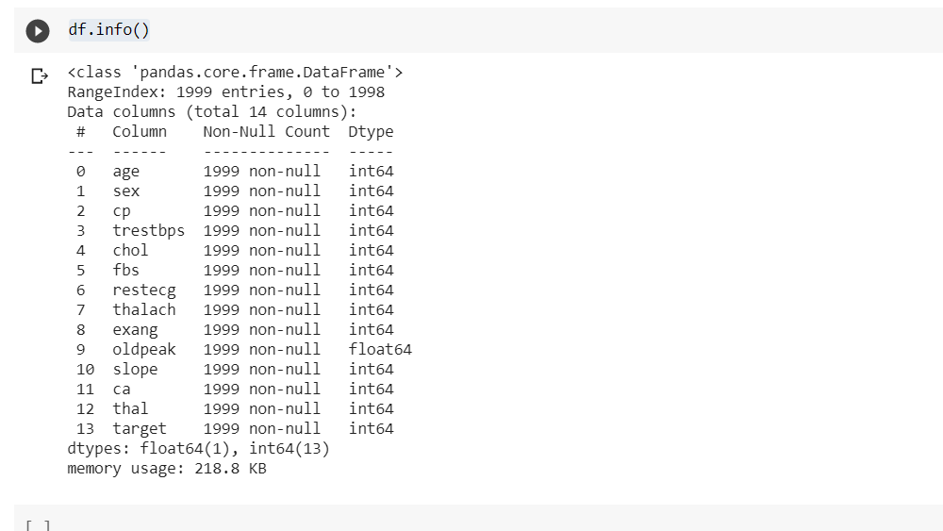
IMPLEMENTATION

Slide 11
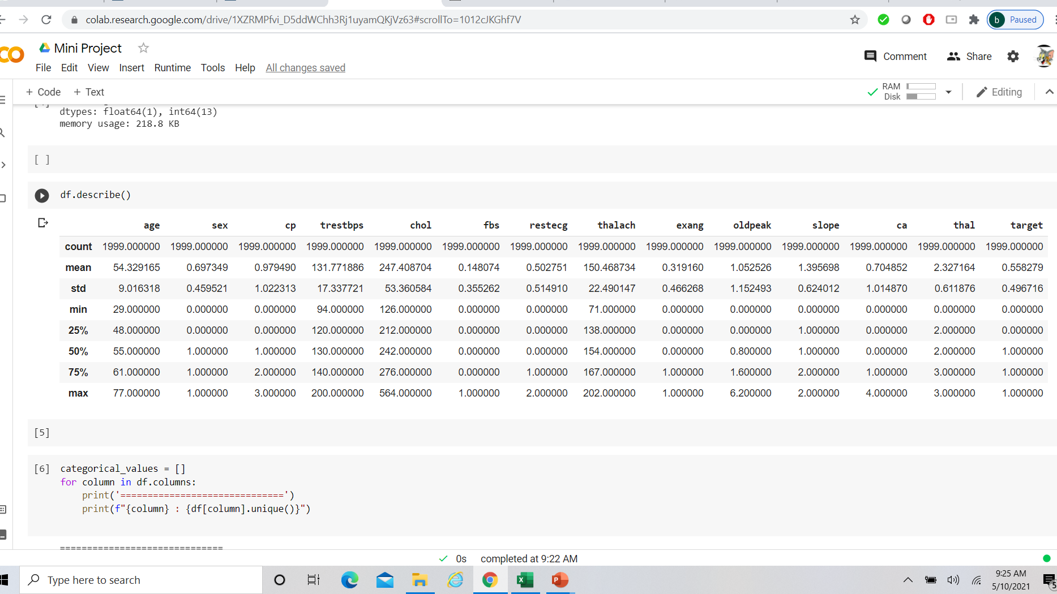
IMPLEMENTATION

Slide 12
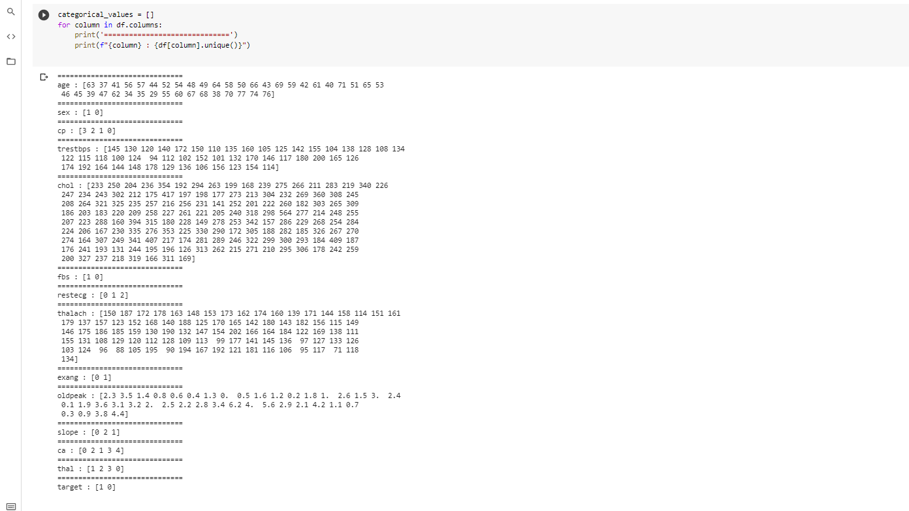
IMPLEMENTATION

Slide 13
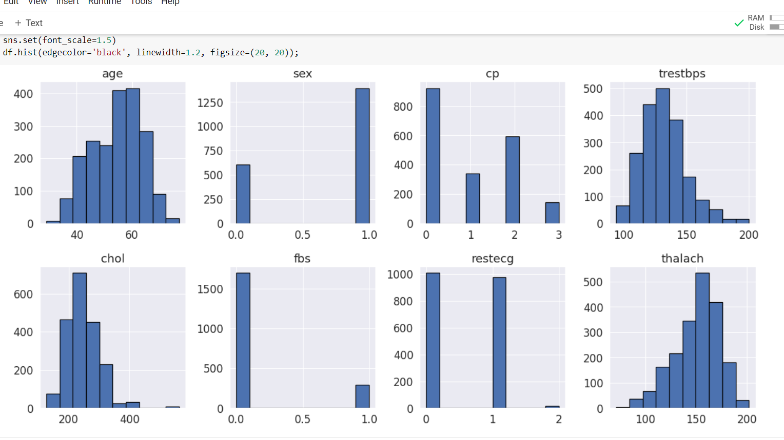
IMPLEMENTATION

Slide 14
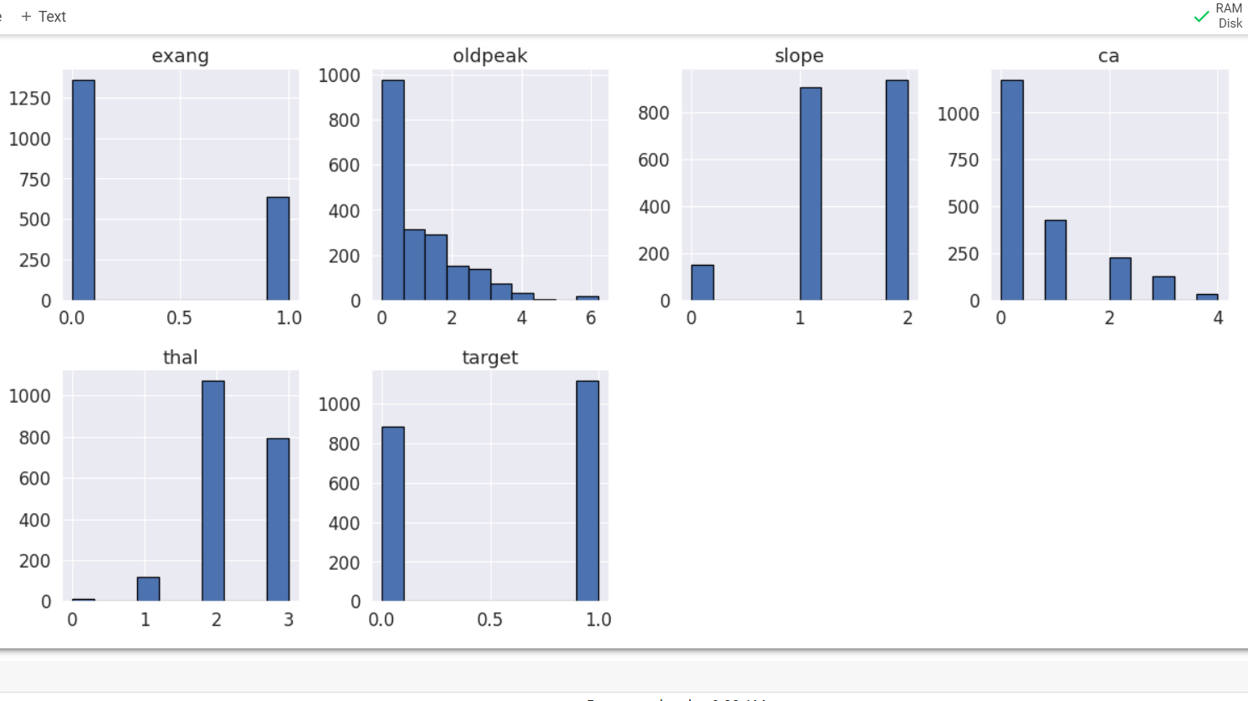
IMPLEMENTATION

Slide 15
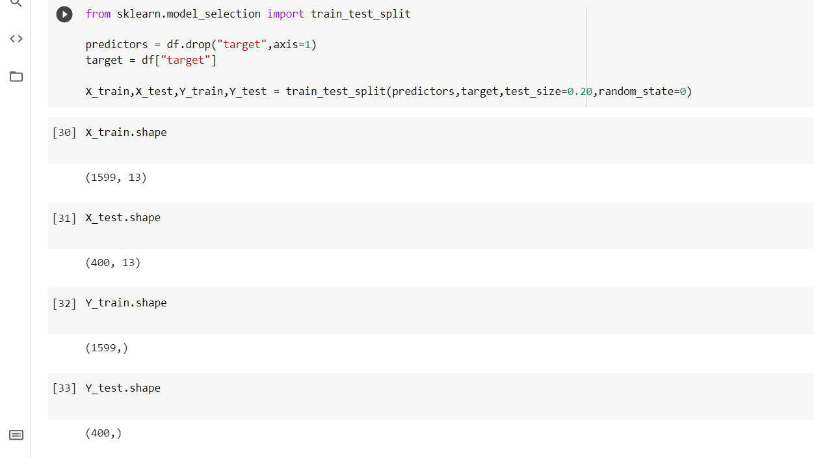
IMPLEMENTATION

Slide 16
Thank You
Submitted By:
19475A0504 – K. Sampath Kumar
18471A05J2 – Ch. Sai Ganesh
18471A05N5 – V. Raju

